Slide 1
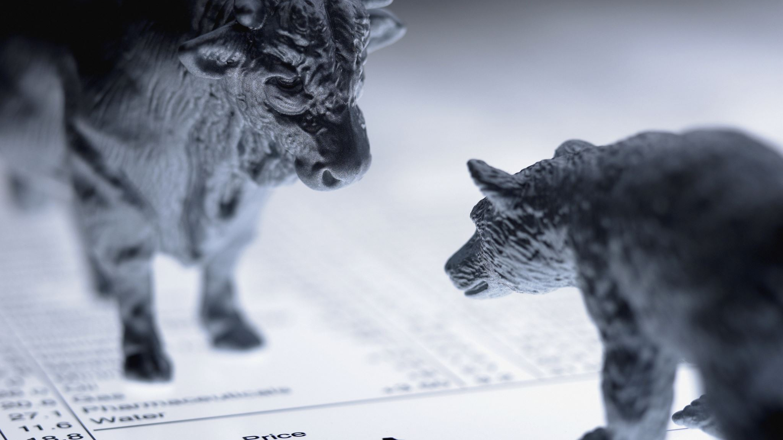
Finance Intelligence Pipeline
Developer: Sadiya Shaikh (2210474)

Slide 2
🎯 Core Purpose
This is a sophisticated end-to-end data pipeline that transforms financial news into actionable investment intelligence.
The pipeline ingests financial news from Yahoo Finance RSS feeds and uses AI to extract meaningful market intelligence, organizing it into investment themes with sector sentiment analysis.

Slide 3
🔄 How It Works
The pipeline follows a 4-step AI processing workflow on top of news ingestion:
Ingest - Fetches articles from Yahoo Finance RSS feeds using feedparser and newspaper3k, stores them as JSON files and database records
Market Events - Claude Sonnet AI extracts discrete factual events from each article
Trends - Identifies cross-article patterns and establishes trends across multiple events
Themes & Sector Sentiment - Groups trends into high-level investment narratives and tags them with sector information and sentiment scores

Slide 4
📊 Data Model
The database includes two main entity groups:
News Intelligence:
NewsArticles → MarketEvents → Trends → Themes → SectorTags (hierarchical enrichment)
Tracks relevance scores and weights at each level
Client Portfolio:
Clients → Accounts → Portfolios → Holdings → Securities → Sectors
Enables matching market themes against client portfolios

Slide 5
🚀 Key Features
Automated Scheduling: Runs every day by default to stay current
AI-Powered Analysis: Uses openAI GPT-4o for event/trend/theme extraction
Flexible Storage: SQLite for dev, PostgreSQL for production
Demo Data: Includes seed scripts for testing
Report Generation: Outputs investment themes with visual sentiment indicators

Slide 6
Examples
NewsArticle:
Example:
id: 42
title: "NVIDIA Beats Q4 Earnings, Fed Signals Rate Cut"
summary: "Strong GPU sales..."
is_processed: False → True (after we process it)
2. MarketEvent (Output of Stage A):
create discrete events from article.
Example from that article:
Event 1: id=100, article_id=42, event_text="NVIDIA beats earnings",
event_type="EARNINGS", entities=["NVDA"]
Event 2: id=101, article_id=42, event_text="Fed signals rate cut",
event_type="MACRO", entities=["FED"]
3. MarketEventTrend (Many-to-Many Bridge):
Links events to trends with a relevance score.
After Stage B (clustering), you get:
Trend 1: id=1000, name="AI Infrastructure Build-Out"
Trend 2: id=1001, name="Rising Rate Environment"
Then the links created:
MarketEventTrend: event_id=100 → trend_id=1000, relevance_score=0.95
MarketEventTrend: event_id=100 → trend_id=1001, relevance_score=0.3
MarketEventTrend: event_id=101 → trend_id=1001, relevance_score=0.92

Slide 7
4. TrendTheme (Many-to-Many Bridge)
Links trends to high-level themes.
After Stage C (distillation), you get:
Theme 1: id=500, name="AI Revolution"
Theme 2: id=501, name="Monetary Tightening"
Then the links:
TrendTheme: trend_id=1000 → theme_id=500
TrendTheme: trend_id=1001 → theme_id=501
5. SectorTag (One-to-Many: Theme → Sectors)
Each theme gets tagged with affected sectors + sentiment.
For Theme 1 ("AI Revolution"):
SectorTag: theme_id=500, sector_name="Semiconductors",
sentiment="Positive", confidence=0.95,
rationale="GPU demand surging"
SectorTag: theme_id=500, sector_name="Energy",
sentiment="Negative", confidence=0.70,
rationale="Data center power costs rising"

Slide 8
Visual of storing actual data:
ARTICLE 42: "NVIDIA Beats Q4 Earnings, Fed Signals Rate Cut"
│
├─ EVENT 100: "NVIDIA beats earnings" (EARNINGS)
│ ├─ links to TREND 1000 (score: 0.95) → THEME 500: "AI Revolution"
│ │ ├─ Semiconductors (+Positive, 0.95)
│ │ └─ Energy (-Negative, 0.70)
│ │
│ └─ links to TREND 1001 (score: 0.3) → THEME 501: "Monetary Tightening"
│
└─ EVENT 101: "Fed signals rate cut" (MACRO)
└─ links to TREND 1001 (score: 0.92) → THEME 501: "Monetary Tightening"

Slide 9
Summary Table: How Data Flows
Layer | Table | Purpose | Real Example
Input | news_articles | Raw ingested articles | Nvidia article ingested from Yahoo Finance
AI Extract | market_events | Discrete market events | "Alphabet revenue grew 63%", "Stock pullback" (5 events from 1 article)
Pattern | trends | Cross-article patterns | "Alphabet Growth Trend" groups all related events
Narrative | themes | Investment narrative | "Tech Resurgence" groups multiple trends
Tagging | sector_tags | Sector + sentiment | Technology sector = POSITIVE (0.9 confidence)
Client Match | client_theme_matches | Portfolio exposure | Arjun's 62.52% tech exposure matches "Tech Resurgence"
Holdings | holdings | Actual positions | Arjun owns 200 NVDA @ $900 = $180K

